Slide 1



The Central Role of Hub Leaders in the Development and Sustained Impact of NSI
Jennifer Russell
Jennifer Sherer
Megan Duff
Chris Matthis
Hanan Perlman
Anna Premo
Don Peurach
Liz Jones
Tony Bryk
Angel Li
Dave Sherer

Slide 2
Purpose:
Spotlight the work of NSI hub leaders
Opening up the “black box” of hub leadership
Three hub leader challenges:
  Managing inward and outward
  Navigating shifting environmental contexts
  Designing for lasting impact
Looking ahead: Next steps in our research agenda

Slide 3
Opening up the “black box” of hub leadership

Slide 4
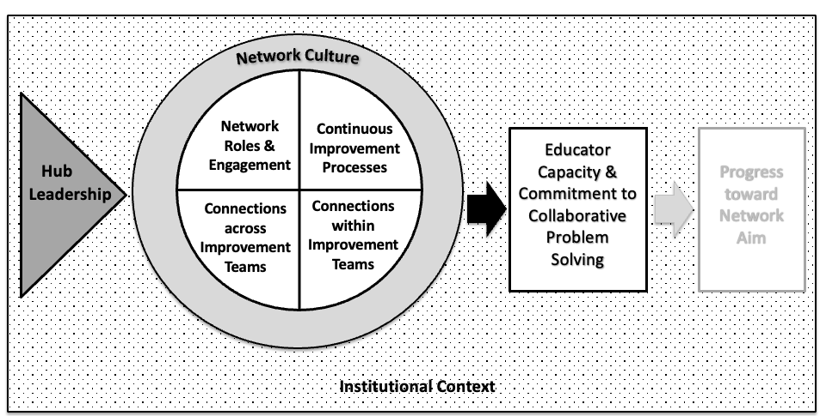
What and who are hub leaders?

Slide 5
What and who are hub leaders?
Within the NSI portfolio, the answer to this question is not so straightforward. Out of 212 hub members who participated in the 2024 Network Health Survey
We documented 151 distinct role titles
A plurality of respondents (43%) shared that their role spanned executive, managerial, and technical responsibilities within the network
Of the 262 hub members who participated in the 2020-2021 Network Health Survey:
48% had less than two years of experience in network leadership
Only 60% reported they had formal leadership preparation. Of those 60%, the majority came into the hub through school or district leadership pipelines.

Slide 6
What is the practical work of hub leadership?
Domains of practical work include:
  Supporting improvement activity within the network
  Developing and managing the NSI’s hub
  Building and managing the network
  Managing relationships external to the NSI
  Integrating equity in the NSI
  Analyzing and improving the NSI
  “Putting out fires”

Slide 7
What are the challenges of hub leadership?
Three big categories:
Working in an emerging and underdeveloped professional field
Conventional challenges of change management
Managing temporary adhocracies in established educational contexts
Three specific examples:
Managing inward and outward (i.e., system alignment)
Navigating shifting environmental contexts
Designing for lasting impact

Slide 8
Managing inward and outward
The “system alignment” challenge

Slide 9
Managing inward and outward:
The “system alignment” challenge
Hub leaders must work to simultaneously craft coherence among schools within the network and ensure their work is prioritized within their broader district context.
Most hub leaders have no formal authority over network schools
Separation from district authority can facilitate trust
Participation in network activities is largely voluntary
Two measures on NHDS related to this issue:
Alignment to school priorities
Alignment to district priorities

Slide 10
What are we learning about the NSI with strong alignment?
System alignment is not related to structural characteristics of NSI
Common practices among hub leaders in NSI with strong alignment:
System alignment is likely a function of hub leaders’ practices and system conditions
Robust processes for school & member selection
Strategic connections with leaders across school & district levels
Intentional roles for school & district leaders
Balancing decision rights with network members

Slide 11
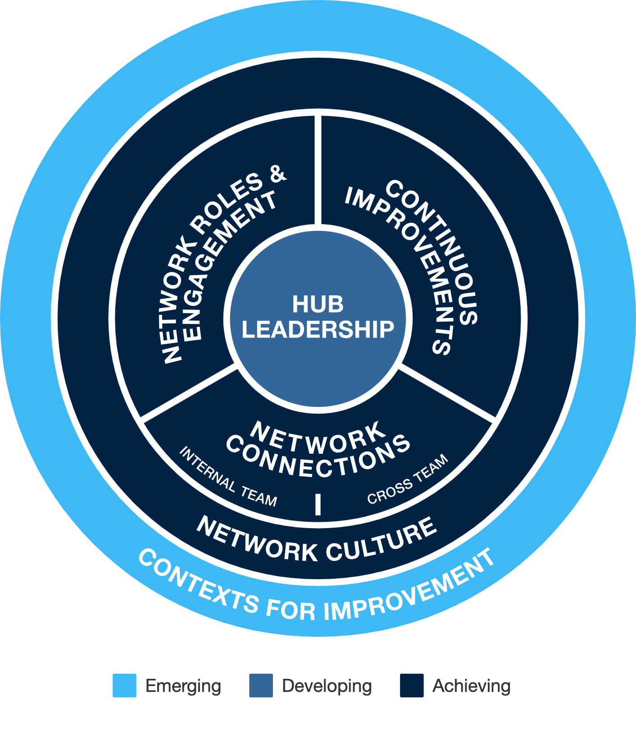
How does system alignment matter for NSI?
“There is no culture of improvement at my school outside of the [network] community. Leadership does not attend [network] meetings and are not familiar with improvement science. There is a culture of ‘accountability’, but this results in finger-pointing, band-aid solutions, and a ‘put out the fires’ mentality.”
– Network member

Slide 12
Navigating shifting environmental contexts
The “equity” challenge

Slide 13
Navigating shifting environmental contexts: The “equity” challenge
Three major exogeneous shocks during the NSI initiative:
  COVID-19 pandemic
  Racial unrest and protests
  National press for attention to diversity, equity, and inclusion
Within the NSI initiative, the equity press has been particularly salient
Equitable outcomes → equity in processes & outcomes

Slide 14
How did hub leaders respond to the increased press for equity?
 | Outcomes | Opportunities | Power | Identity
Definition | Designing for network outcomes that are equitable across demographic characteristics such as race, socioeconomic status, and/or gender | Providing time, resources, and capacity-building opportunities for individuals to integrate equity in improvement | Sharing voice and agency with those who are traditionally disempowered; challenging systems of oppression | Understanding one’s own identity and potential biases; learning about and valuing the identities and experiences of others
Percent Prioritized | 100% | 79% | 64% | 45%
Examples | Data disaggregation Measuring the impact of DEI practices | Equity-focused professional learning & convenings Coaching for equity | Empathy interviews Co-design | Empathy interviews Shifting adult mindsets

Slide 15
Planning for lasting impact
The “sustainability” challenge

Slide 16
Broadening our conceptualization of sustainability:
Planning for lasting impact:
The “sustainability” challenge
To what extent did NSI transform the educators, schools, and systems with which they worked?
What aspects of this work might stick?
Change ideas
Continuous improvement (CI) practices
Network aim
Collaboration for improvement within schools
Collaboration for improvement across schools
Teachers’ professional networks
Sustaining the impact of this work at the individual, school, and/or system level
Sustaining a network

Slide 17


What aspects of NSI practice do hub leaders aim to sustain?
Network aim | CI processes | Change idea(s) | Within school collaboration | Across school collaboration | Number of network hubs
 |  |  |  |  | 10
 |  |  |  |  | 8
 |  |  |  |  | 4
 |  |  |  |  | 3
 |  |  |  |  | 3
In addition to the above clusters, 6 network hubs were focused on sustaining 1-2 areas of their work, but these areas of focus varied by hub.

Slide 18
Looking Ahead: Next Steps in Our Research Agenda
Continuing data collection
  Network Health Survey
  Sustained Impact: Hub leader interviews & network case studies
Explore the relationship between hub leadership, network health and development, and educator and student outcomes
Practical resources to support professional learning and network development
A series of academic papers addressing the content of these discussions

